Slide 1

6th Grade Accelerated Math
Unit 10, Lesson 10 Making Population Predictions – Part 2 Volume 2, pg. 158

Slide 2


Benchmark
MA.7.DP.1.3
Given categorical data from a random sample, use proportional relationships to make predictions about a population.
volume 2, pg. 158

Slide 3
Integrated Mathematical Thinking and Reasoning Standards
MA.K12.MTR.1.1 Actively participate in effortful learning both individually and collectively.
MA.K12.MTR.4.1 Engage in discussions that reflect on the mathematical thinking of self and others.
MA.K12.MTR.6.1 Assess the reasonableness of solutions.
MA.K12.MTR.7.1 Apply mathematics to real-world contexts.
volume 2, pg. 158

Slide 4

Learning Target
I can use proportional relationships to make predictions about a population.
volume 2, pg. 158

Slide 5

Warm-Up
volume 2, pg. 158

Slide 6
10.10.1 Warm-Up: Bell Work
Antonia and her aunt go fishing at Lake Okeechobee every Sunday. For the past four Sundays, Antonia has kept track of what kinds of fish they caught.
 | Bluegill | Bream | Crappie | Largemouth Bass
Number of Fish Caught Last Month | 10 | 12 | 20 | 8
Expected Number of Fish to Be Caught Next Sunday
Complete the table to show what type and how many fish Antonia and her aunt are likely to catch next Sunday when they go fishing.
volume 2, pg. 158
Notes:
Video Link: https://algebranation.wistia.com/medias/fi4fidi5y8

Slide 7

Guided Practice
volume 2, pg. 158

Slide 8

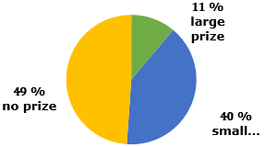
10.10.2 Guided Practice: Making Population Predictions
Ella gathered data from a Rubber Duck Pool Game. The circle graph below shows the percentage of people who won a large prize, a small prize, and no prize.
Prizes Won in Rubber Duck Game
volume 2, pg. 158

Slide 9
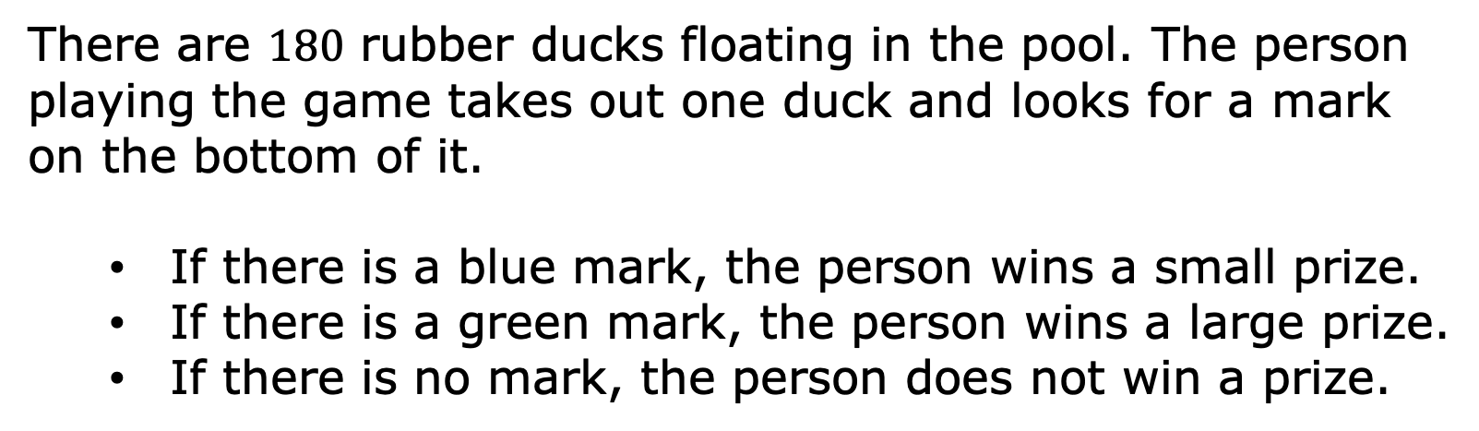
There are $180$ rubber ducks floating in the pool. The person playing the game takes out one duck and looks for a mark on the bottom of it.
If there is a blue mark, the person wins a small prize.
If there is a green mark, the person wins a large prize.
If there is no mark, the person does not win a prize.
volume 2, pg. 158

Slide 10
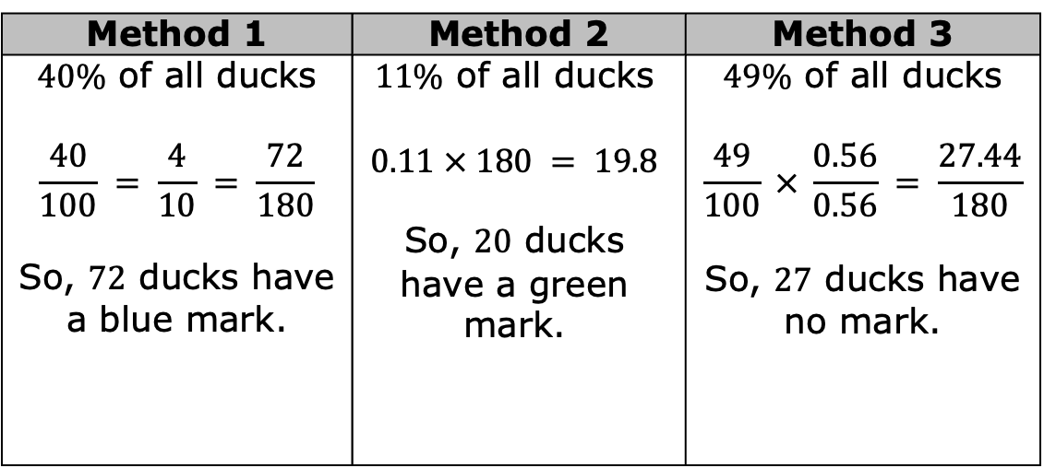
Ella uses her data to predict how many of each kind of duck are in the pool using three different strategies. Her work is shown.
Method 1 | Method 2 | Method 3
$40\%$ of all ducks $$\frac{40}{100} = \frac{4}{10} = \frac{72}{180}$$ So, 72 ducks have a blue mark. | $11\%$ of all ducks $$0.11 × 180 = 19.8$$ So, 20 ducks have a green mark. | $49\%$ of all ducks $$\frac{49}{100} × \frac{0.56}{0.56} = \frac{27.44}{180}$$ So, $27$ ducks have no mark.
volume 2, pg. 159

Slide 11
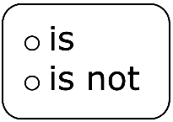
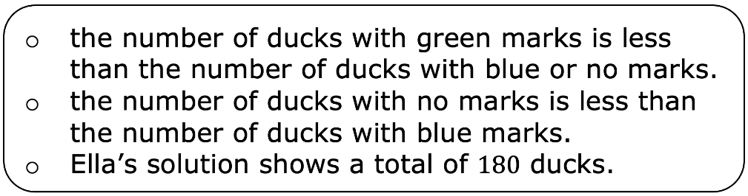
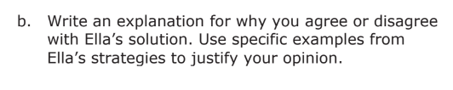
a. Ella’s solution correct because
volume 2, pg. 159

Slide 12



When using a scale factor, first divide the population by the sample to find the scale factor, then multiply the numerator and denominator of the sample fraction by the scale factor.
When using an equivalent fraction, write multiple fractions equal to the sample fraction until the denominator shows the total population.
When using a percent, multiply the total population by the decimal or fraction form of the percent of the sample.
volume 2, pg. 159

Slide 13
Bianca picks blocks out of a bag one at a time. She picks out a block, records the color, and puts the block back in the bag. She cannot see the blocks, but she knows there are 6 blocks in the bag. Of the 50 times she picked a block out of the bag, she picked a blue block 29 times, a red block 10 times, and a yellow block 11 times.
Write ratios to show the number of times Bianca picked a blue, red, and yellow block out of the bag.
Blue _____ Red _____ Yellow ______
volume 2, pg. 159

Slide 14
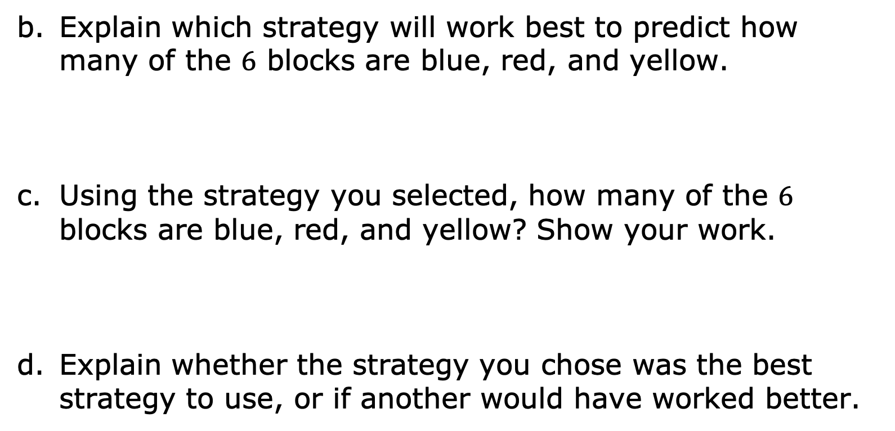
Explain which strategy will work best to predict how many of the $6$ blocks are blue, red, and yellow.
Using the strategy you selected, how many of the $6$ blocks are blue, red, and yellow? Show your work.
Explain whether the strategy you chose was the best strategy to use, or if another would have worked better.
volume 2, pg. 160

Slide 15

Collaboration
volume 2, pg. 160

Slide 16

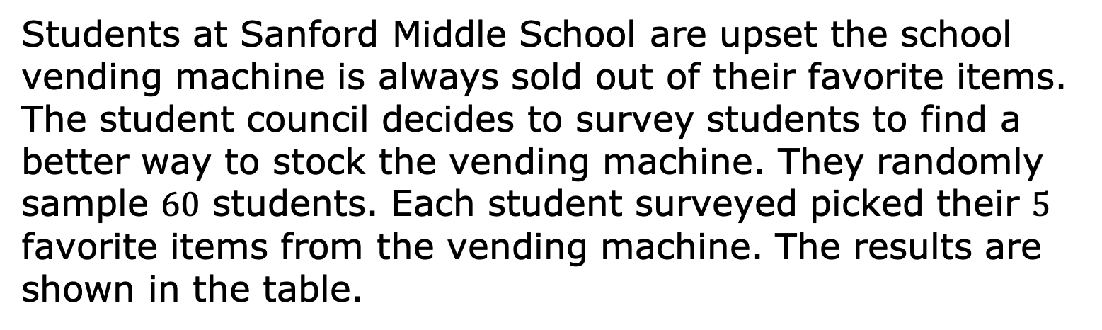
10.10.3 Collaboration: Stocking a Vending Machine
Students at Sanford Middle School are upset the school vending machine is always sold out of their favorite items. The student council decides to survey students to find a better way to stock the vending machine. They randomly sample $60$ students. Each student surveyed picked their $5$ favorite items from the vending machine. The results are shown in the table.
volume 2, pg. 160

Slide 17
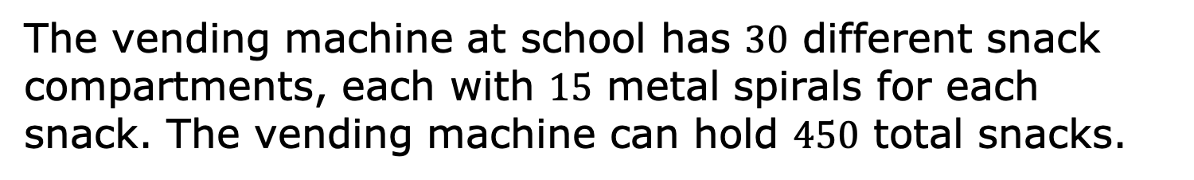
Item | Number of Times Chosen in Survey | Number that Should be Stocked
Reese’s | 30
Skittles | 24
Starburst | 21
Snickers | 42
Pretzels | 24
Chips | 30
Takis | 39
Gum | 36
M&Ms | 30
Trail Mix | 24
The vending machine at school has $30$ different snack compartments, each with $15$ metal spirals for each snack. The vending machine can hold $450$ total snacks.
volume 2, pg. 160

Slide 18
Work with your partner to decide how many of each snack should be stocked in the vending machine. Complete the table with your decision.
Your work will be assessed using these criteria.
Each of the strategies: scale factor, equivalent fraction, and percent are used. If one of the strategies is not used, there is an explanation for why the strategy was not used.
It is clear, either from your work or a written explanation, why you have stocked the vending machine the way you did.
The number of each snack stocked in the vending machine is a direct reflection of the survey results.
volume 2, pg. 161

Slide 19

Your Turn
volume 2, pg. 161

Slide 20
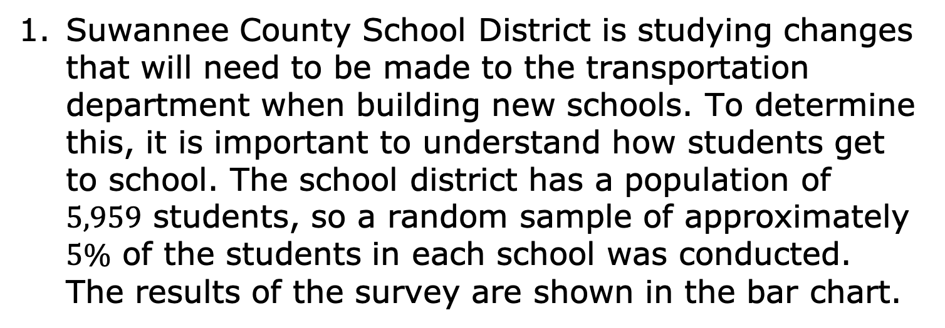
10.10.4 Your Turn!
Suwannee County School District is studying changes that will need to be made to the transportation department when building new schools. To determine this, it is important to understand how students get to school. The school district has a population of $5,959$ students, so a random sample of approximately $5\%$ of the students in each school was conducted. The results of the survey are shown in the bar chart.
volume 2, pg. 161

Slide 21
Number of Students
Transportation Type
Show how to predict the number of students in the district who take the bus to get to school.
volume 2, pg. 161

Slide 22
Show how to predict the number of students in the district who ride their bike to school.
Whether or not a student can take the bus to school depends on how close they live to the school. Explain how this data set does not take this into consideration and what effect that might have on the district’s decision.
volume 2, pg. 162

Slide 23

Wrap-Up
volume 2, pg. 162

Slide 24
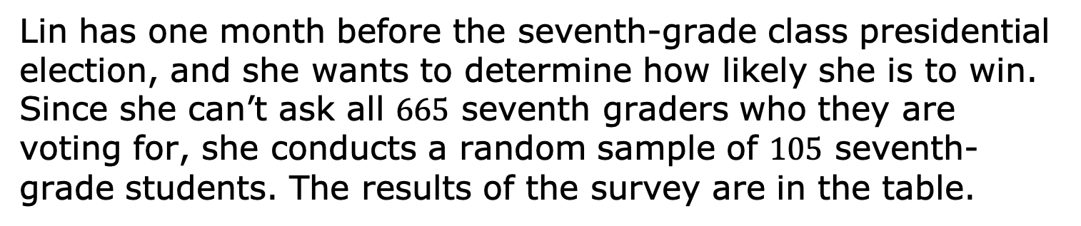
10.10.5 Wrap-Up: Ticket Out the Door
Lin has one month before the seventh-grade class presidential election, and she wants to determine how likely she is to win. Since she can’t ask all $665$ seventh graders who they are voting for, she conducts a random sample of $105$ seventh-grade students. The results of the survey are in the table.
Candidate | Number of People Planning to Vote for the Candidate
Lin | 42
Beslinda (Lin’s opponent) | 30
Undecided | 33
volume 2, pg. 162

Slide 25
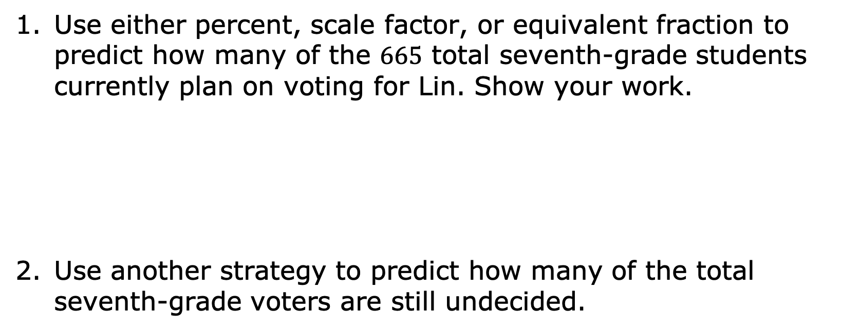
Use either percent, scale factor, or equivalent fraction to predict how many of the $665$ total seventh-grade students currently plan on voting for Lin. Show your work.
Use another strategy to predict how many of the total seventh-grade voters are still undecided.
volume 2, pg. 162

